Slide 1
Danfoss-Mini TT Shaft Bearing Press
Team 512
April 4, 2024

Slide 2





Team Introductions
Clark Cooley
Systems Engineer
Cassie Bentley
Research Engineer
Colby Gullo
Safety Engineer
Brent Mynard
CAD Engineer

Slide 3


Sponsors
Engineering Mentor
Kevin Lohman
Sponsor
Engineering Mentor
William Bilbow
Point of Contact & Sponsor

Slide 4
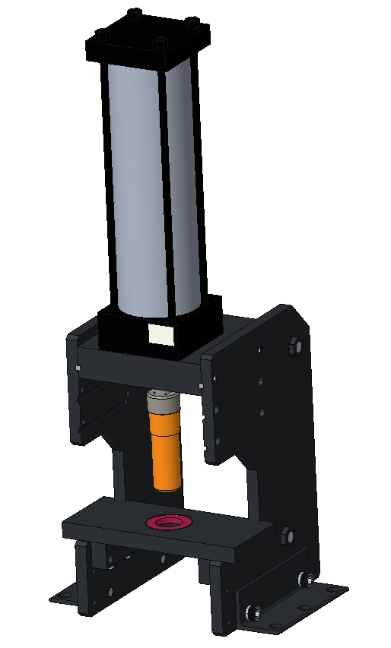
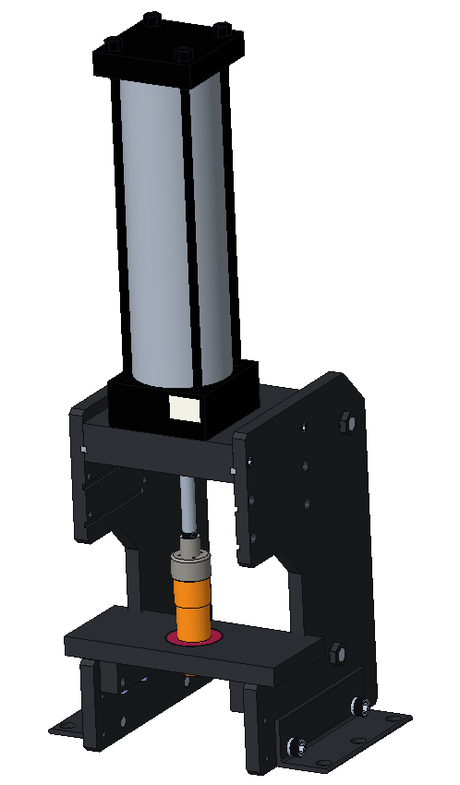
Shaft Bearing Press Process
The bearing is heated to 600 degrees Fahrenheit then placed on the baseplate. ​
The shaft is then placed on the chuck and make sure it is securely fastened.​
The shaft is then pressed onto the bearing for a set amount of time.​
​
The bearing is heated then placed on the baseplate.
The shaft is placed on chuck then is lowered down.
Shaft is then pressed onto the bearing for a set time.

Slide 5
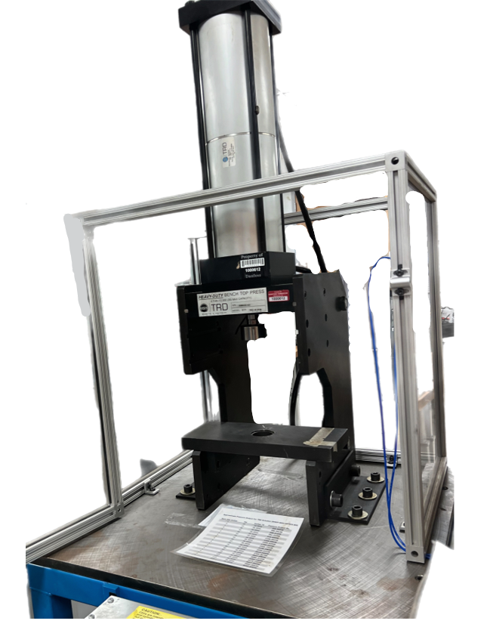
Objective
The objective of this project is to redesign the existing bearing press to press bearings of various sizes onto shafts, while ensuring ease of manipulation and user safety.

Slide 6
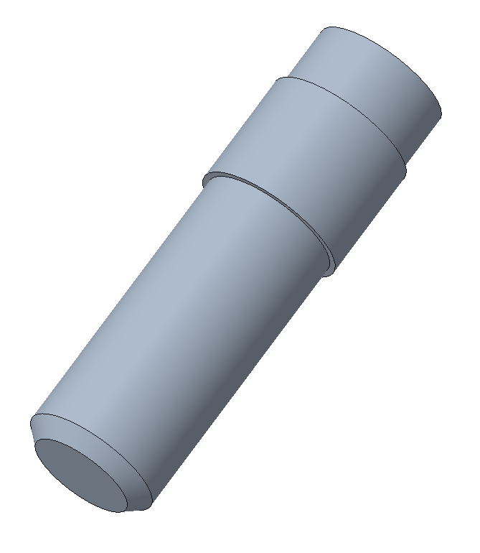
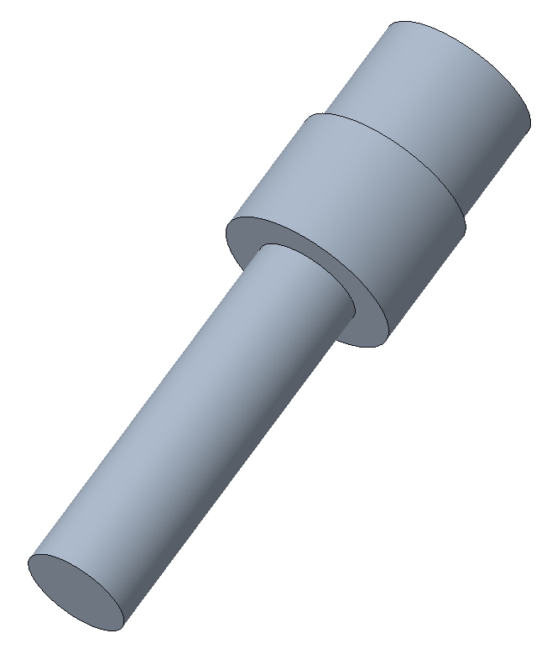
Project Background
Previous Shaft
Length: 5.6 inch
Updated Shaft
Length: 7.5 inch

Slide 7
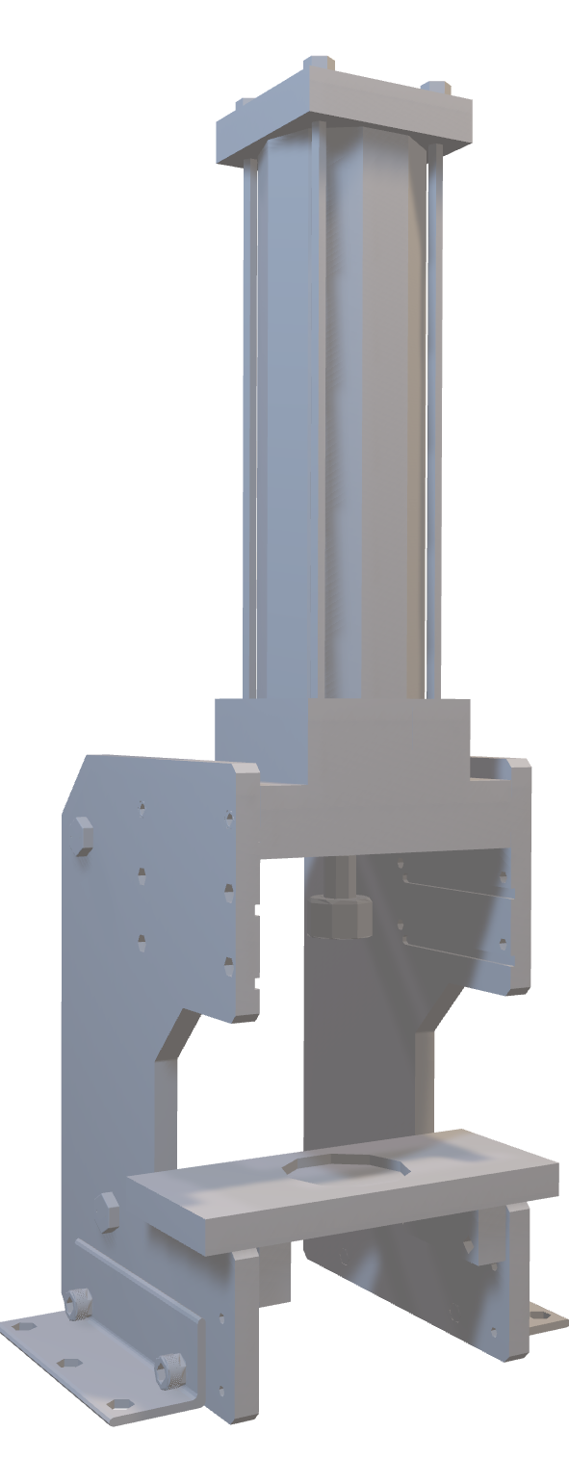
Original Design
Original Design
The original press had several limitations that prevented it from usage.
Press Issues:
Not enough room for new shafts and new bearing housing.
Ineffective cage to protect operator.
Press could operate if door is open.

Slide 8






Key Goals
Height
Adjustability
Press Bearing On Shaft Stud
Ensure Safety Of User
Allow User Ease Of Usage
Optimize Cost

Slide 9


Targets & Metrics
SIZE
PRESSURE
SAFETY

Slide 10
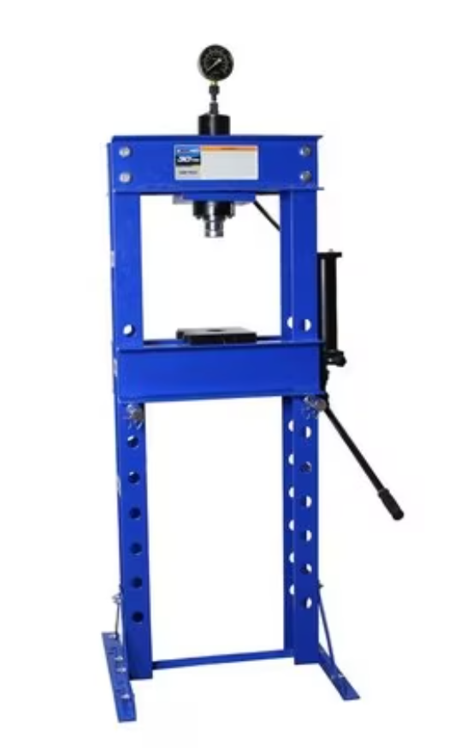
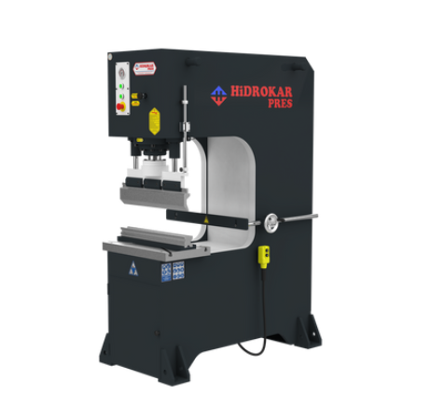




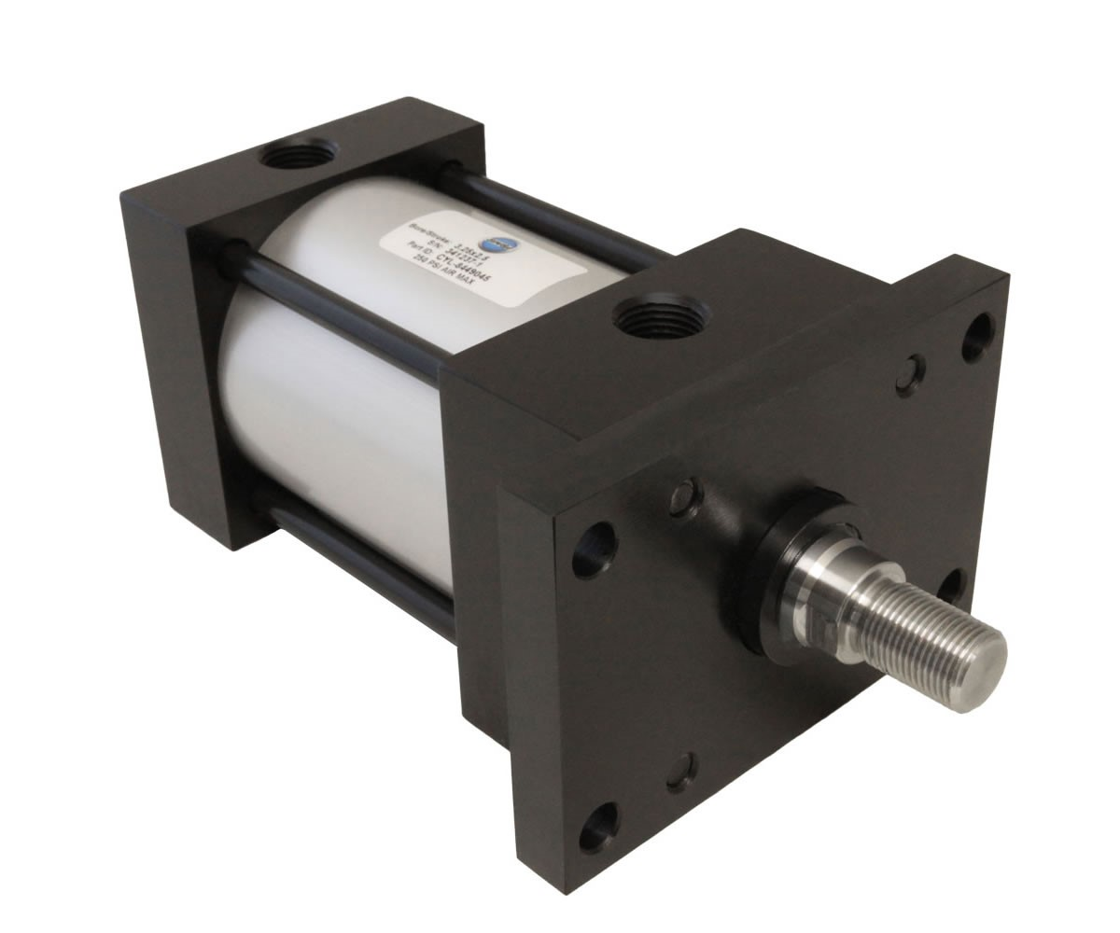
Sponsor Preferences
Sponsor Preferences | Explanation
 | No "H" frame
 | Made in the USA
 | Pneumatic

Slide 11
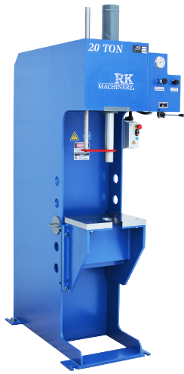
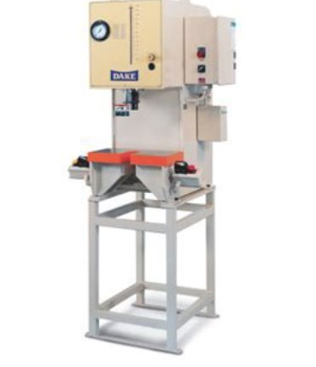
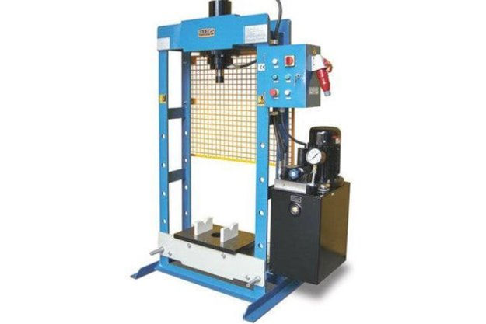
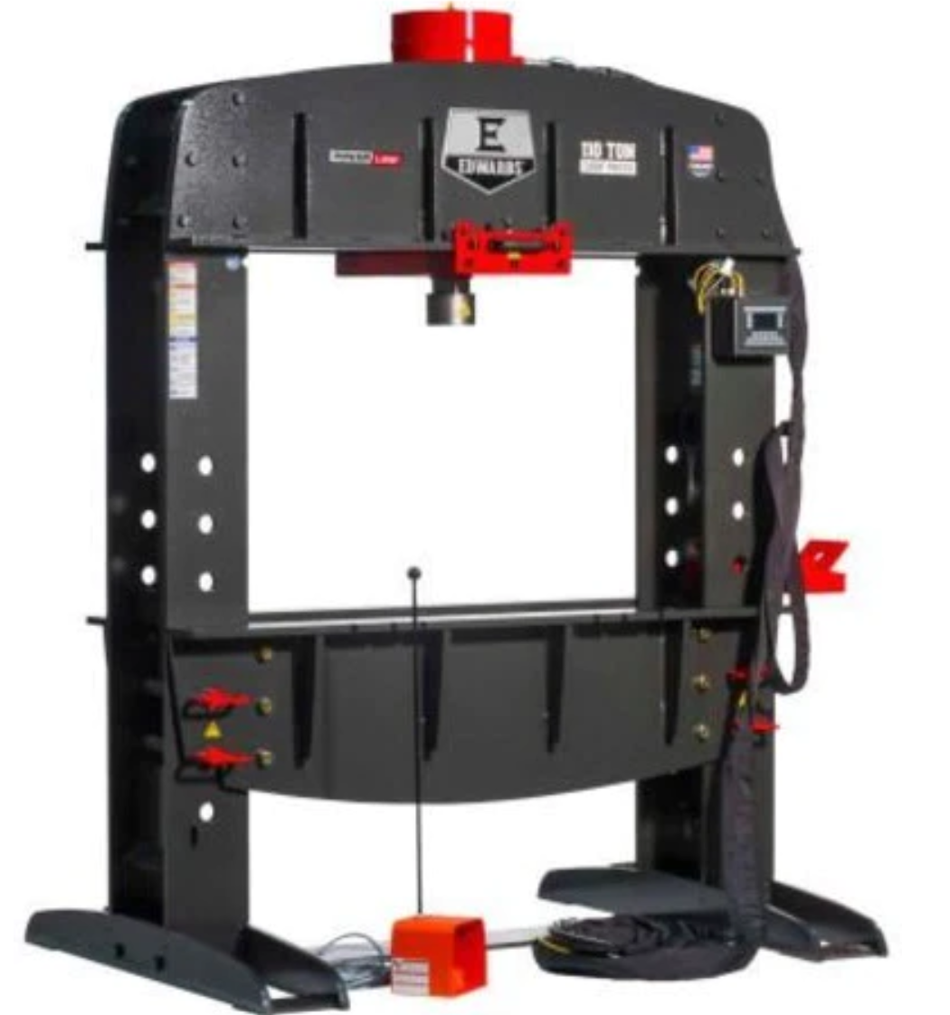
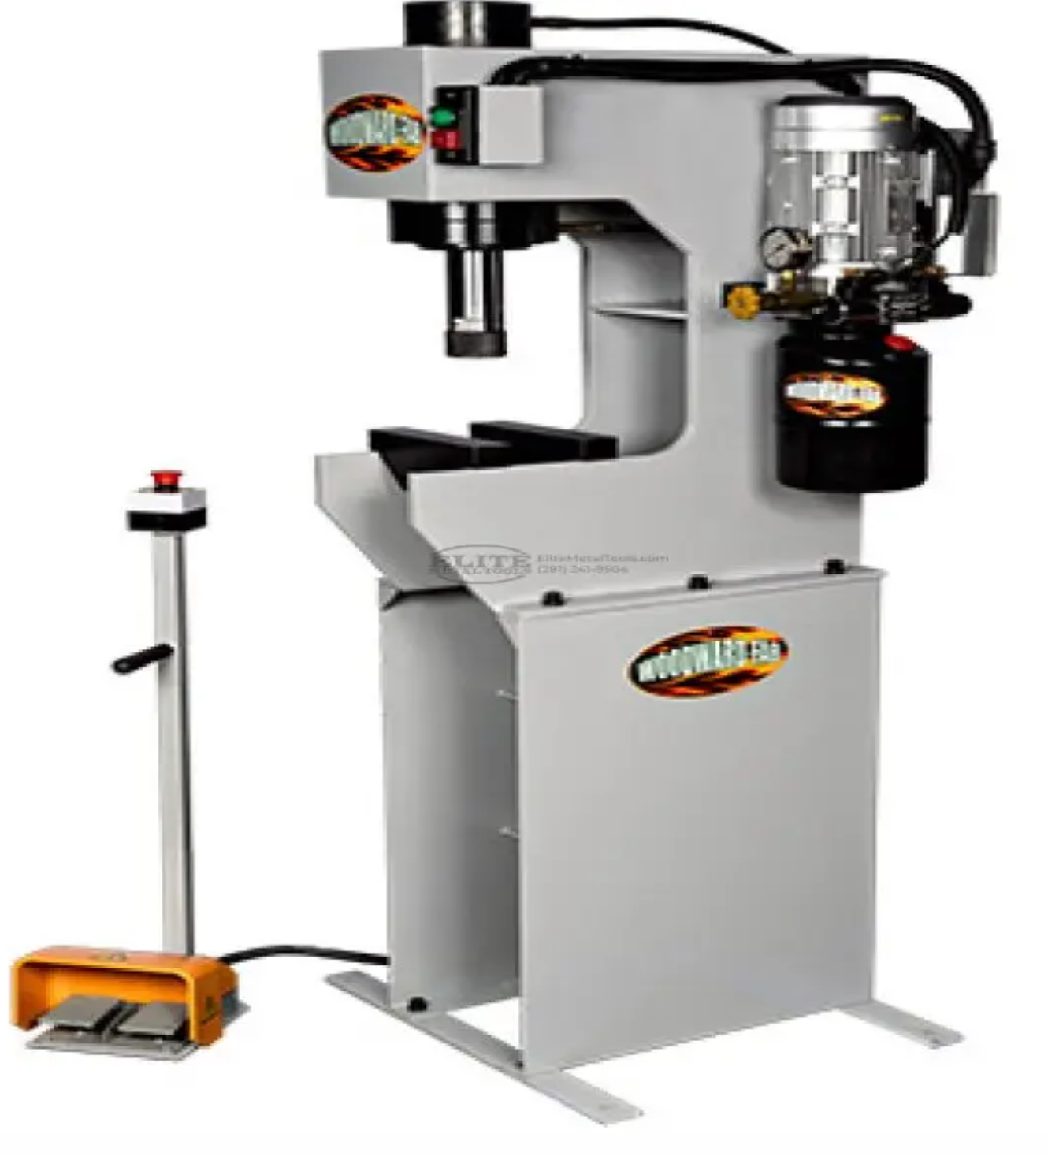
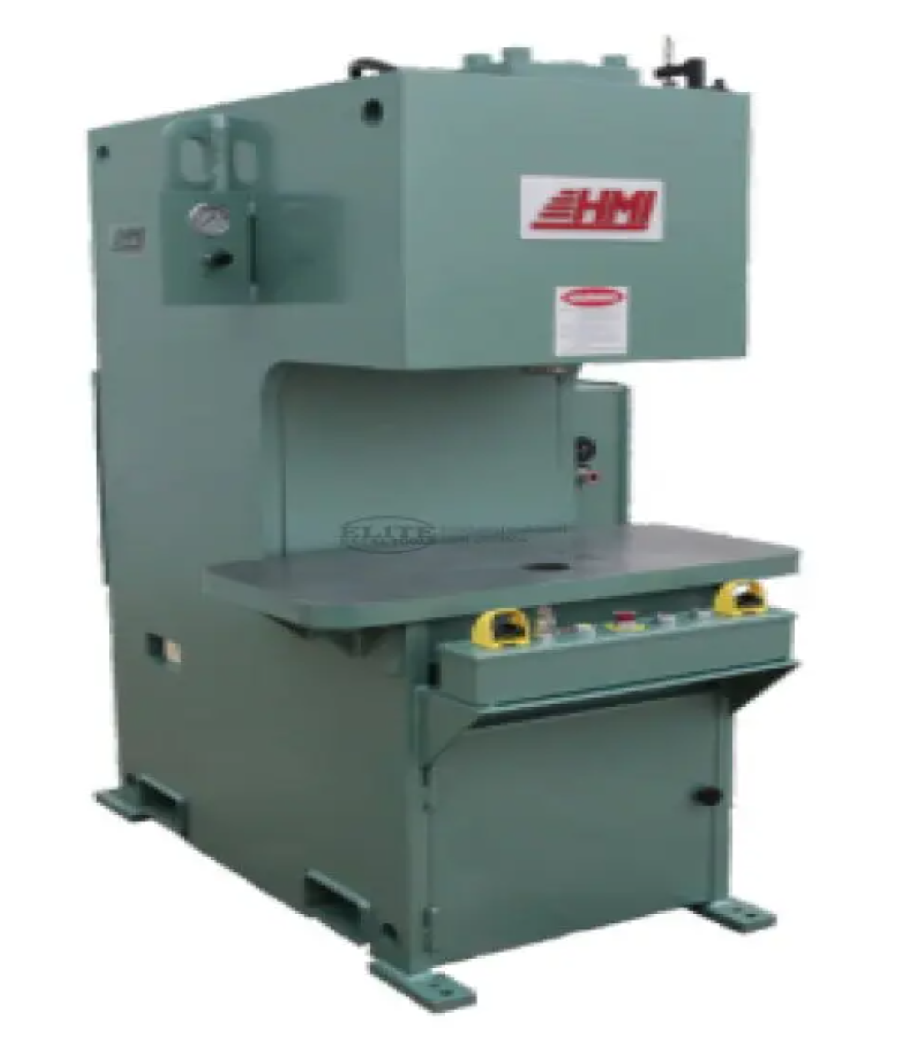
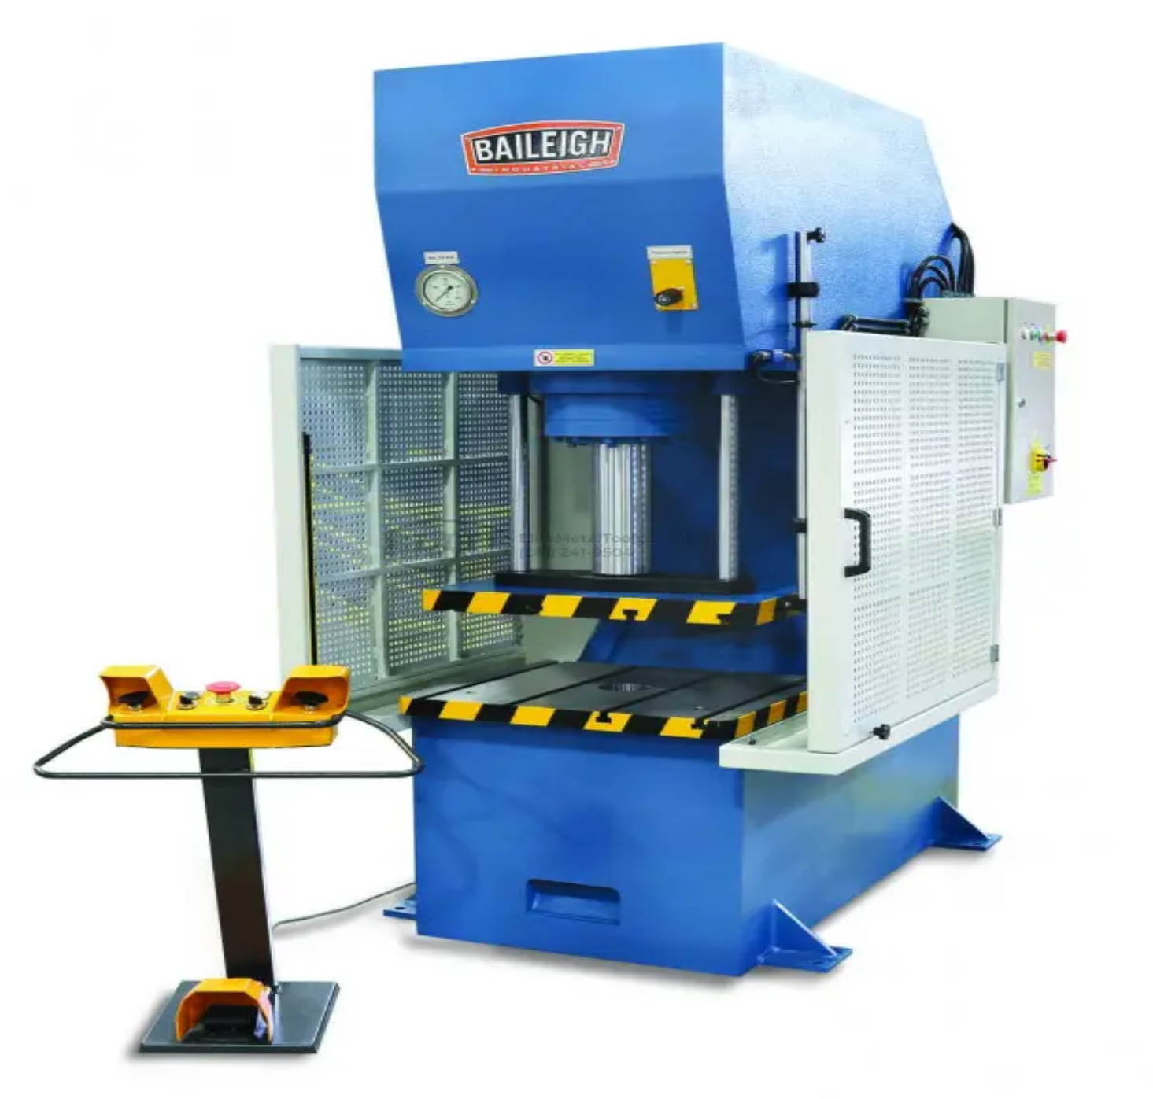
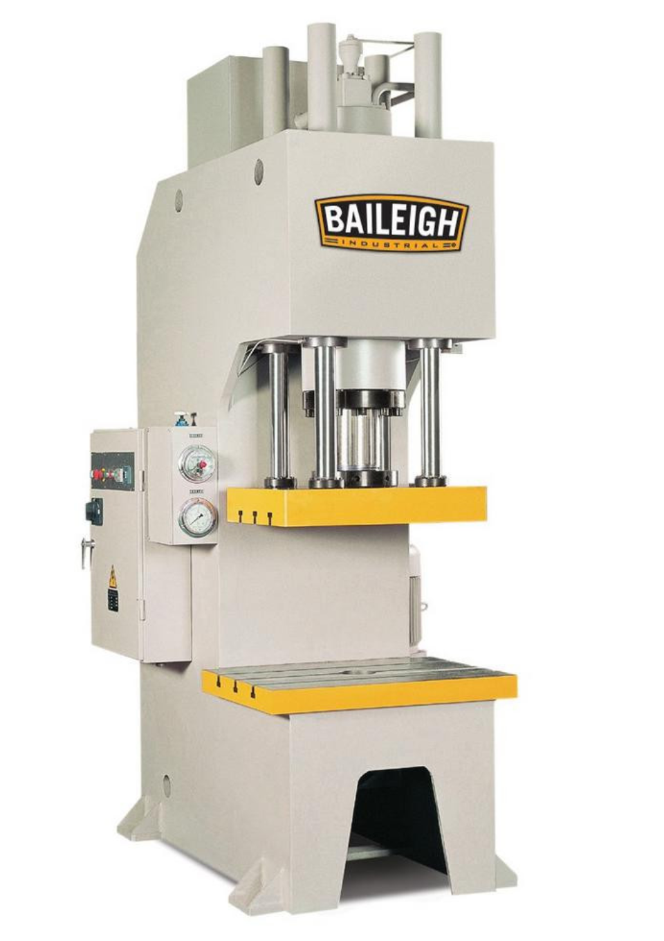
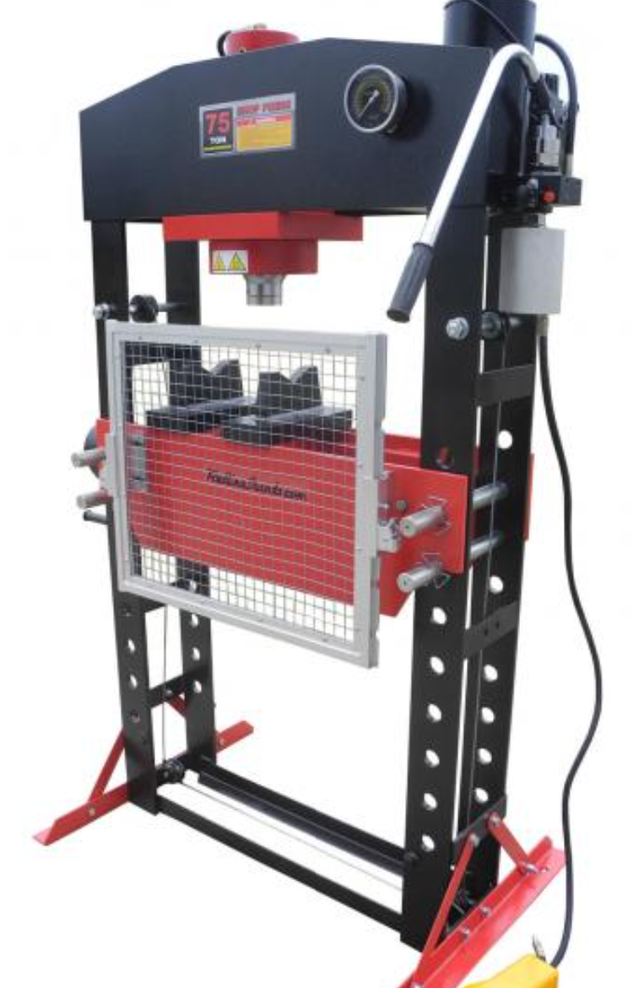
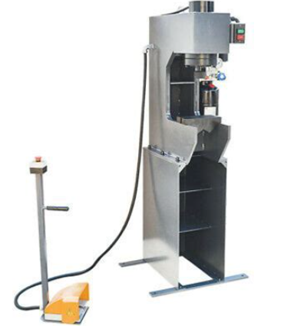
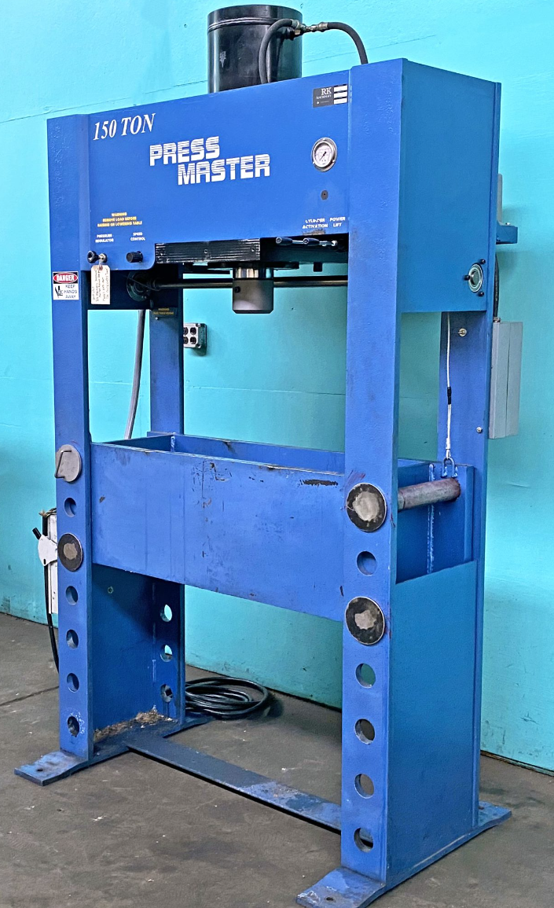
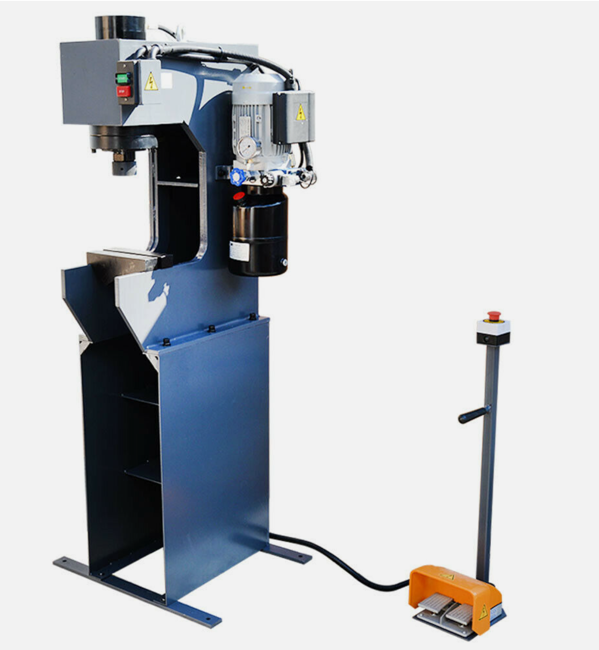
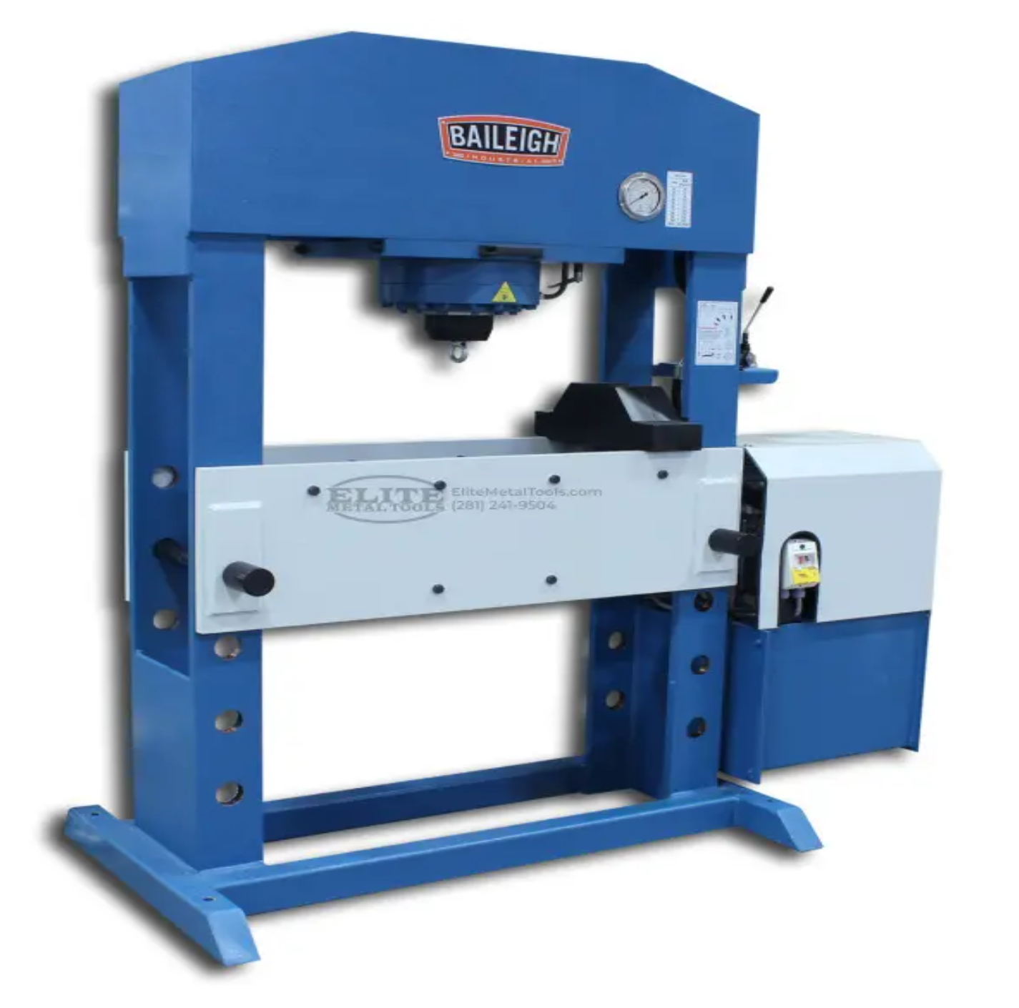
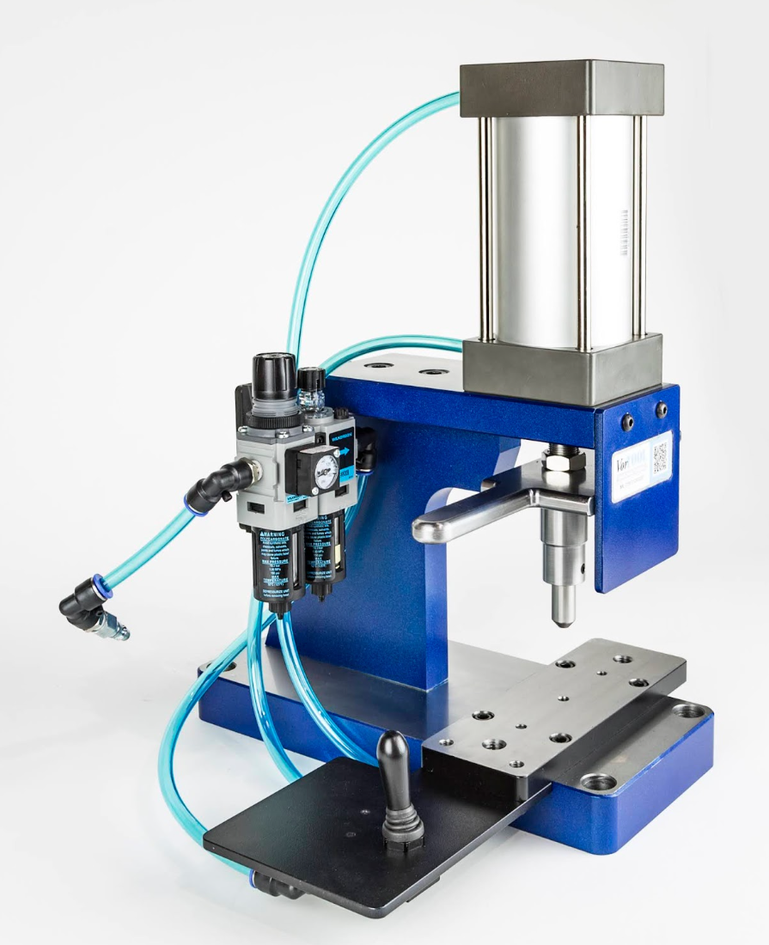
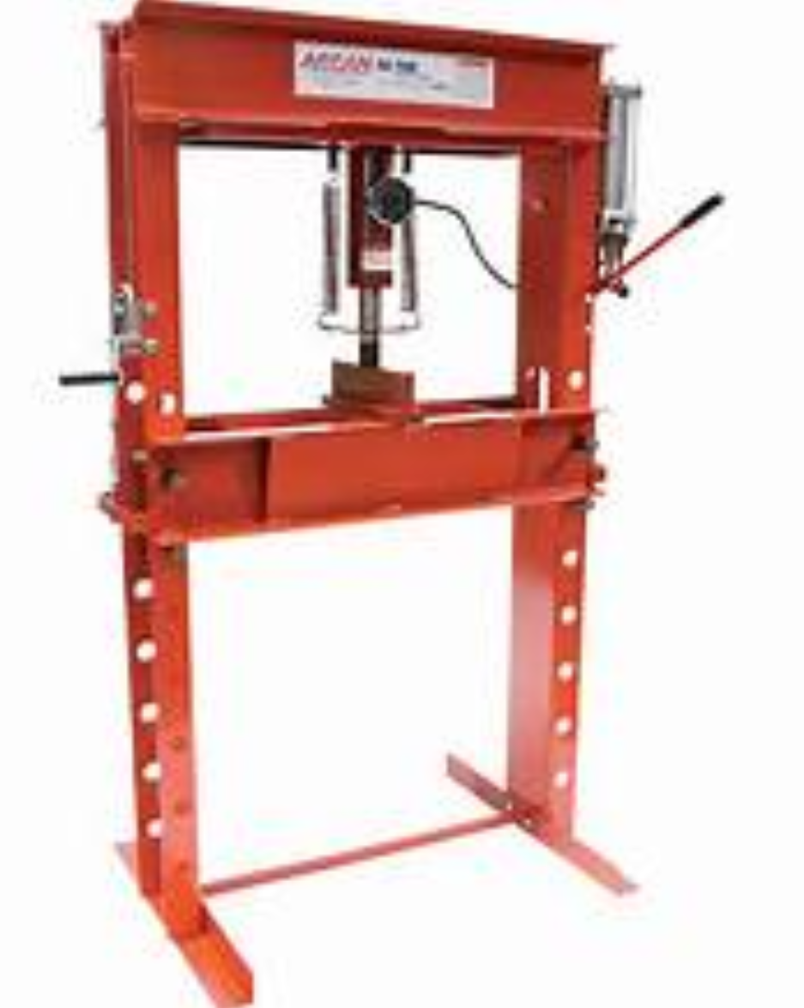
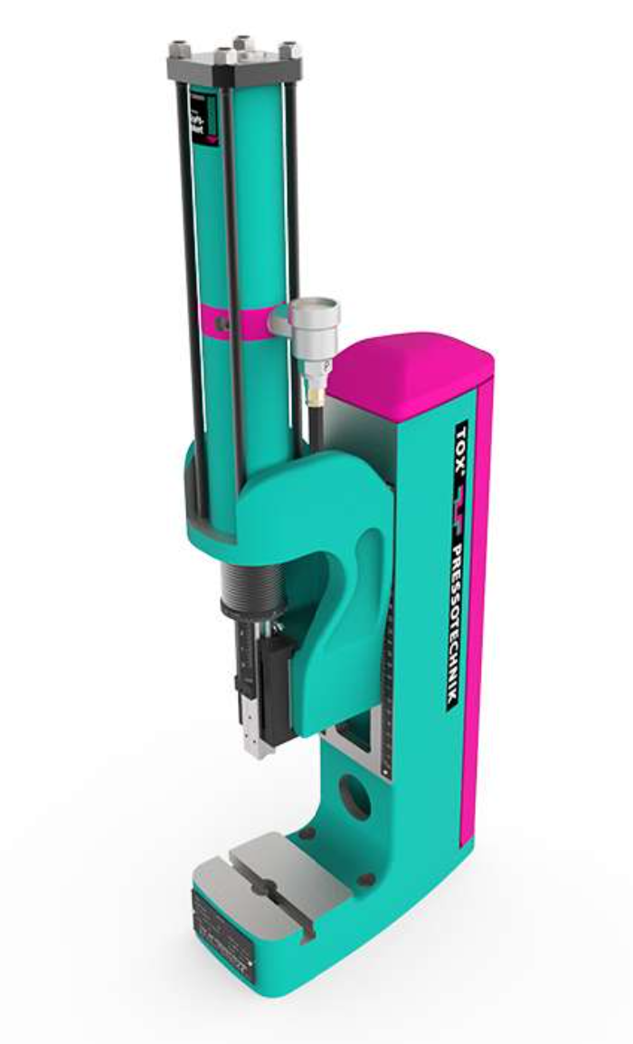
Research & Vendor Communication
We researched presses made in the USA to meet our key goals, evaluating based on cost-effectiveness, features, reputation, and reliability. From our findings, we selected a top three for consideration and recommend one standout option based on our sponsor’s preferences.

Slide 12
Research & Vendor Communication
We researched presses made in the USA to meet our key goals, evaluating based on cost-effectiveness, features, reputation, and reliability. From our findings, we selected a top three for consideration and recommend one standout option based on our sponsor’s preferences.

Slide 13
Press Selection Process
 | 6 Tons | 10 Tons | 20 Tons
Pneumatic | $21,032
Hybrid |  | $37,567
Hydraulic |  |  | $16,500

Slide 14
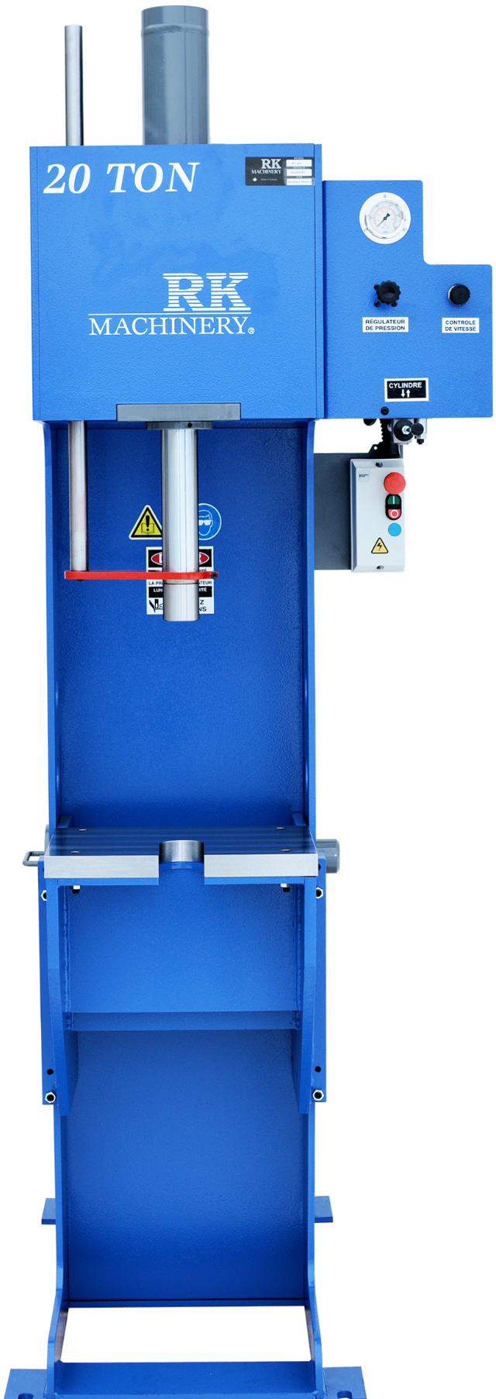


Press Selection
Key Features :
Electric / Hydraulic operation provides
smooth, consistent pressing action
Additive Features-Front safety guard for operator protection.
All hydraulic and mechanical parts are
standard in the industry, and available
throughout North America.
20 Tons
Found a viable press that Danfoss will order in 2025.

Slide 15
Budget Optimization
Unable to make capital purchase
Fulfill the immediate need
Modify the existing press to meet the targets

Slide 16
Optimizing the existing press
Clark Cooley
April 4, 2024

Slide 17
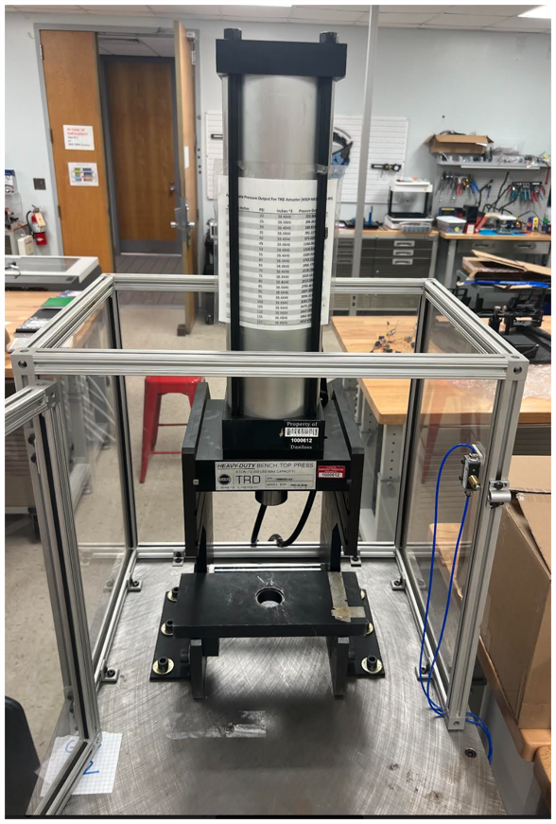
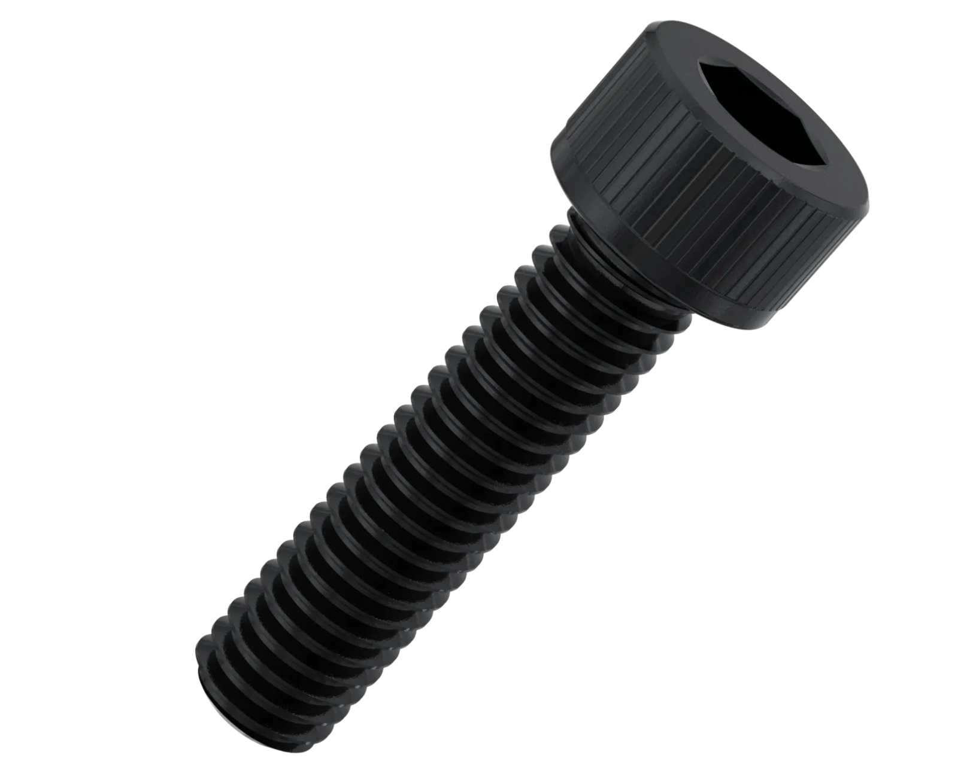
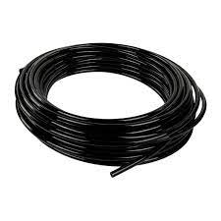
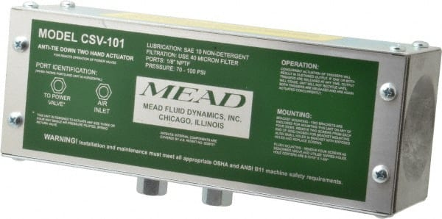
Existing Constraints

Slide 18
Actuator
2 stage 6-ton pneumatic cylinder
Operates at 100 psi (Danfoss standard air compression)
Only outputs 3300 pounds of pressure @ 100 psi

Slide 19
Hardware
Hex bolts are kept to allow the new side panels to fit with the existing press plates.
The nylon tubing was used because it fit with the valves and actuator.
The Actuator is OSHA certified and fits with Danfoss Standards.

Slide 20
Pneumatic Diagram
Air Valve
Compressed Air
2 Stage Cylinder
Chuck
2 Hand Operator
Clark Cooley
20

Slide 21
Pneumatic Diagram
100 PSI
Air Valve
Compressed Air
2 Stage Cylinder
Chuck
2 Hand Operator
Clark Cooley
21

Slide 22
Pneumatic Diagram
100 PSI
Extension
Retraction
Air Valve
Compressed Air
2 Stage Cylinder
Chuck
2 Hand Operator
Clark Cooley
22

Slide 23
Pneumatic Diagram
100 PSI
Extension
Air Valve
Compressed Air
2 Stage Cylinder
Output
Chuck
2 Hand Operator
Clark Cooley
23

Slide 24
Pneumatic Diagram
100 PSI
Retraction
Air Valve
Compressed Air
2 Stage Cylinder
Chuck
2 Hand Operator
Clark Cooley
24

Slide 25
Pneumatic Diagram
100 PSI
Extension
Retraction
Air Valve
Compressed Air
2 Stage Cylinder
Chuck
2 Hand Operator
Clark Cooley
25

Slide 26
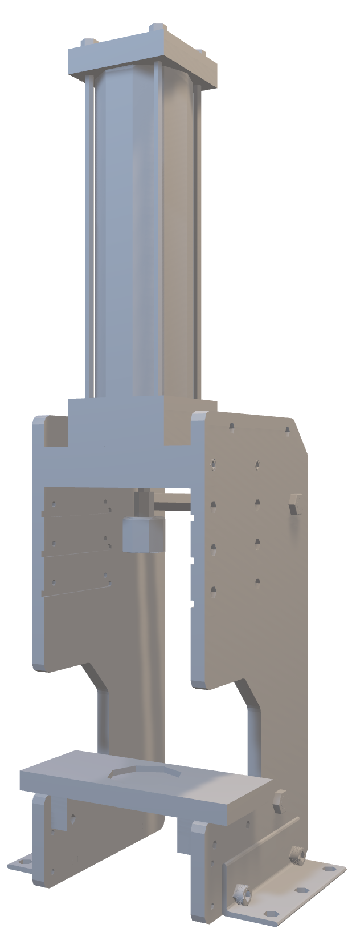
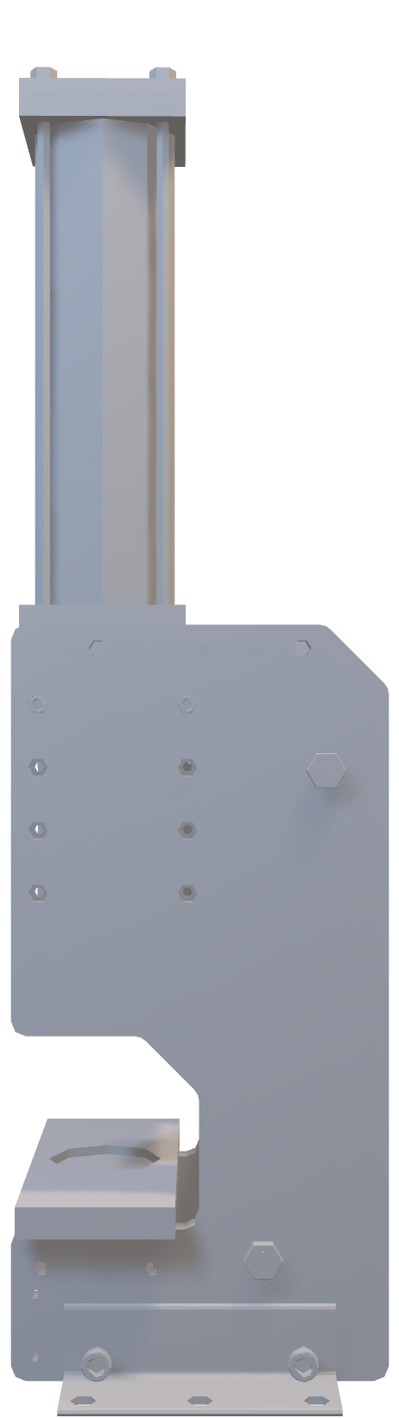
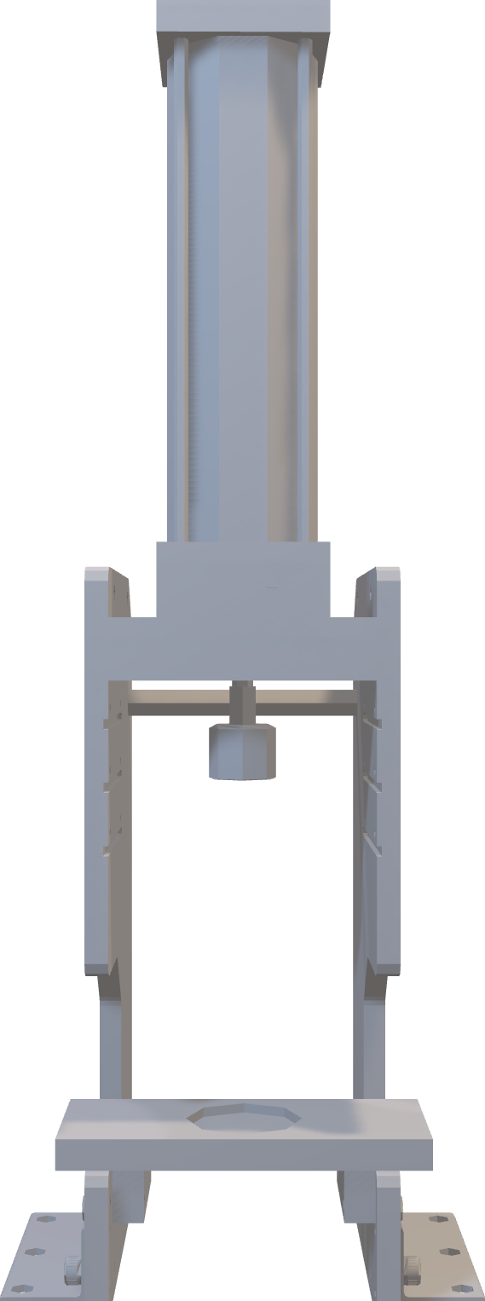
CAD Modeling: New Design
Improvements:
Increased height on side walls
Increased C-shape depth & height for better baseplate support
Additional slots for actuator plate

Slide 27
CAD Modeling: New Design
Depth: 12 in (305 mm)
Height: 24 in (610 mm)
Width: 10 in (254 mm)

Slide 28
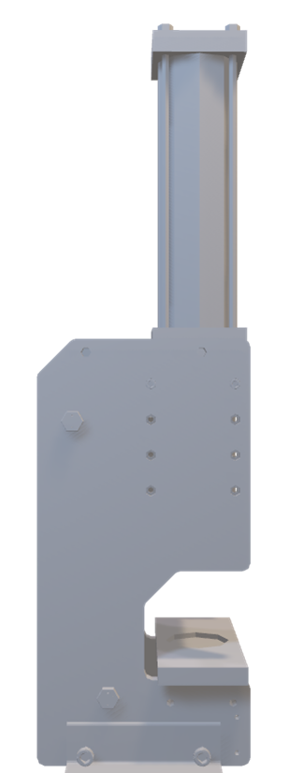
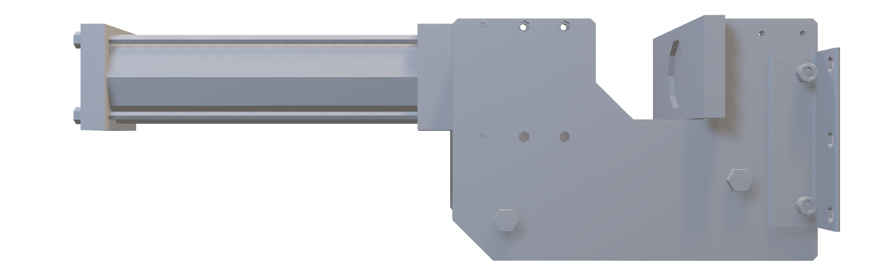
Structural Improvements
New Design
VS
Original Design
4 pairs of pin holes & slots for various heights
3 pairs of pin holes & slots for various heights

Slide 29
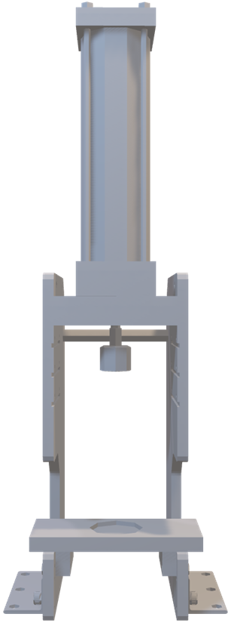
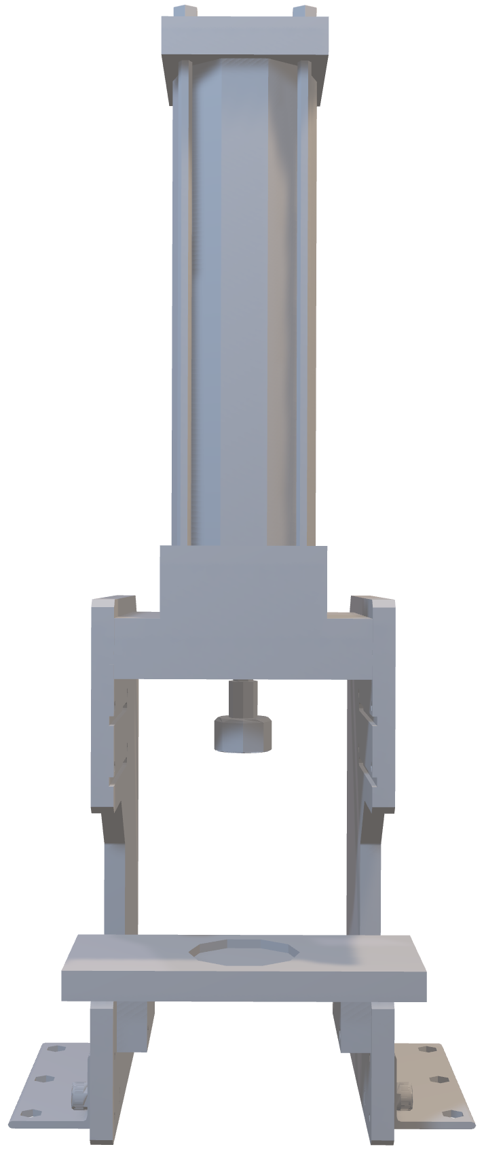
Structural Improvements
New Design
VS
Original Design
Dimensions:
Height: 4.9 ~ 5.6 in
Diameter: 3.9 in
Stroke: 7 inch
Stroke: 7 inch
Daylight: 14.5 inch
(With chuck: 12.7 inch)
Daylight: 10.5 inch
(With chuck: 8.7 inch)

Slide 30
Material Selection
Brent Mynard
April 4, 2024

Slide 31
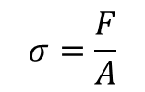
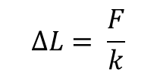
Stress Analysis: Equations
Stress Test Equation
Hooke's Law
Pressure: 100 PSI (Max)
Force Output: 3282.73638 lbs. (Max)
Actuator output area: 38.4846 inch² (24828.7245 mm²)
Applied baseplate area: 60 inch² (38710 mm²)
Applied actuator plate area: 81.6 inch² (52645.056 mm²)

Slide 32
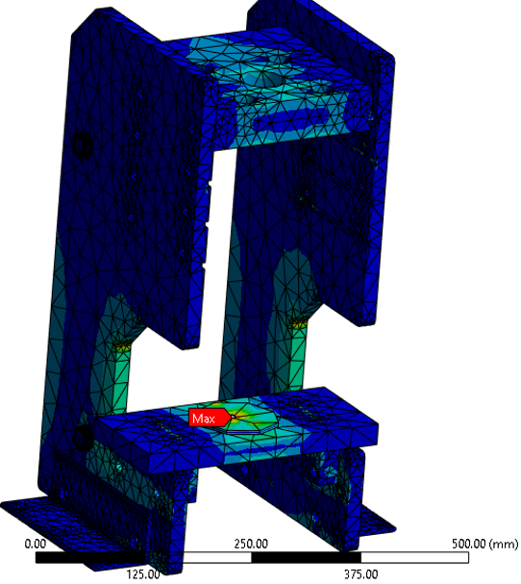
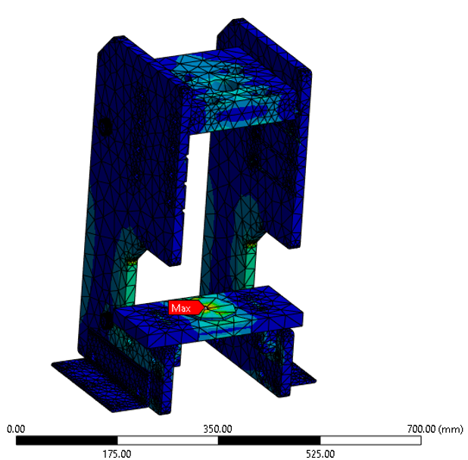
Stress Analysis: Results
1018 Steel
4140 Steel
MAX
24.558 MPa
21.001 MPa
18.668 MPa
16.334 MPa
14.001 MPa
11.667 MPa
9.334 MPa
7.0005 MPa
4.667 MPa
2.3335 MPa
MIN
8.4166e-7 MPa

Slide 33
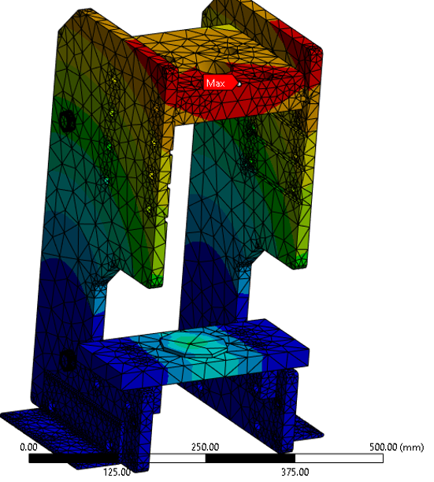
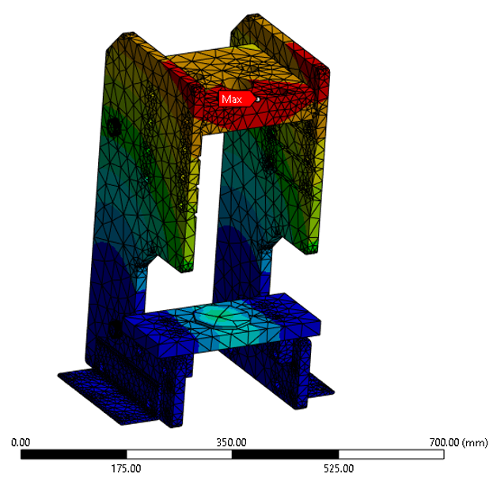
Deformation Analysis: Results
1018 Steel
4140 Steel
MAX
0.05998 mm
0.05259 mm
0.046746 mm
0.040903 mm
0.03506 mm
0.029217 mm
0.023373 mm
0.01753 mm
0.011687 mm
0.0058433 mm
MIN
0.0 mm

Slide 34

Material Selection
1018 Steel | 4140 Steel
1018 steel is easier to machine compared to 4140 steel.
 | 4140 steel can be heat-treated to achieve higher hardness levels, enhancing its wear resistance and durability.
1018 steel is commonly stocked by many suppliers and readily available in various forms and sizes.
12 x 24 x ¾ in Sheet: $340 | 12 x 24 x ¾ in Sheet: $993
To prevent any delays, it was decided to agree on a design first before doing stress and deformation analyses.

Slide 35
Material Selection
1018 Steel | 4140 Steel
1018 steel is easier to machine compared to 4140 steel.
 | 4140 steel can be heat-treated to achieve higher hardness levels, enhancing its wear resistance and durability.
1018 steel is commonly stocked by many suppliers and readily available in various forms and sizes.
12 x 24 x ¾ in Sheet: $340 | 12 x 24 x ¾ in Sheet: $993
To prevent any delays, it was decided to agree on a design first before doing stress and deformation analyses.

Slide 36
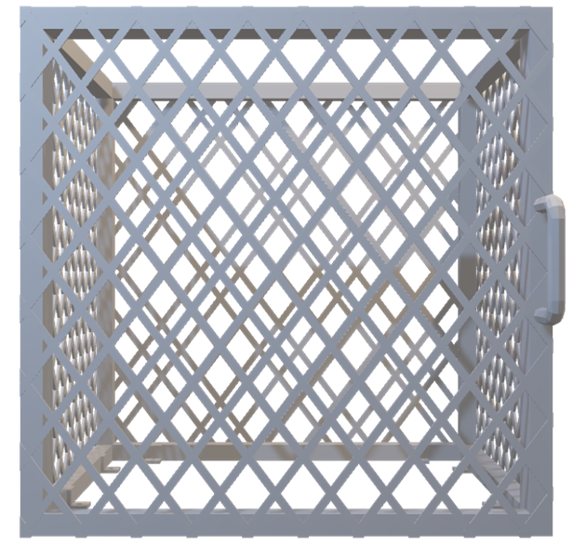
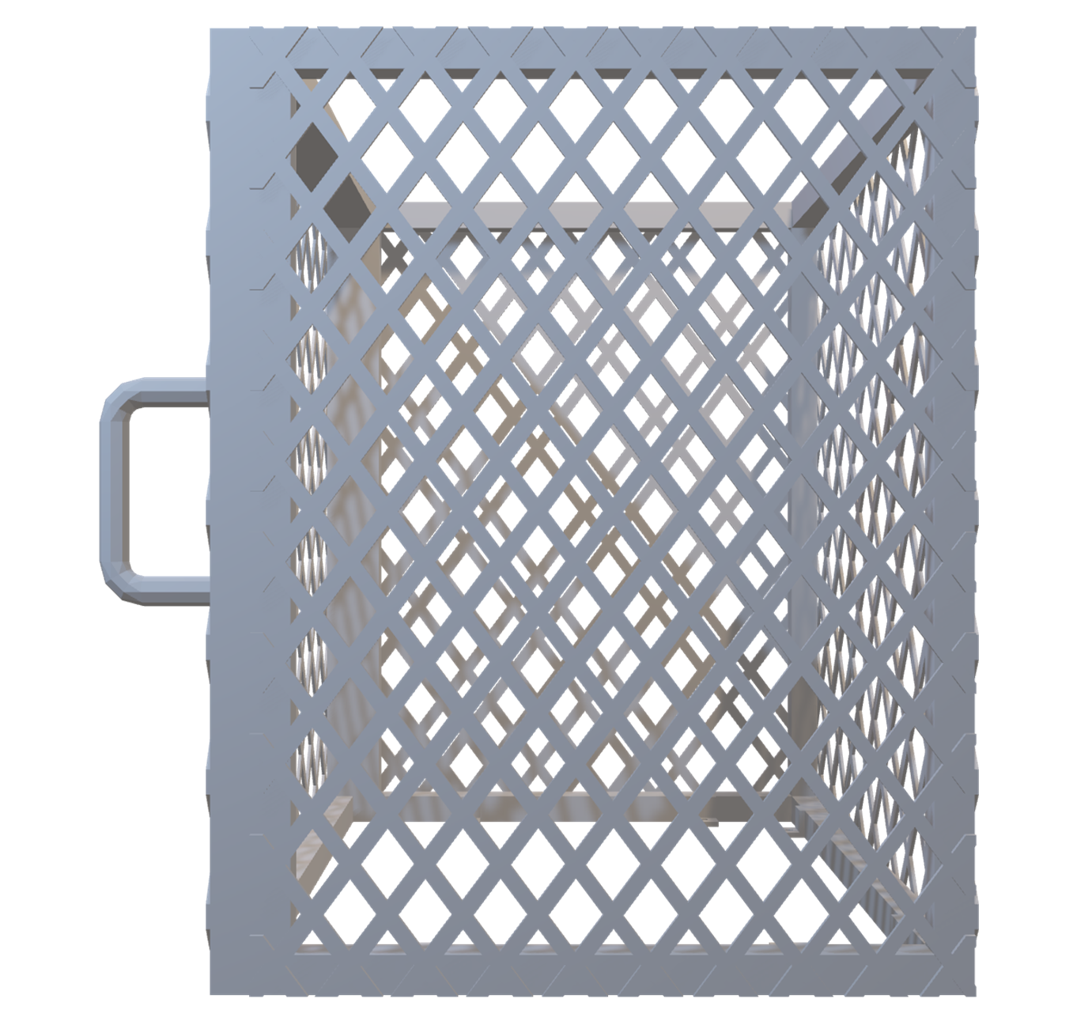
Cage Design
Width: 24 inch
Depth: 19 inch
Height: 24 inch
Bar Thickness: 1 inch

Slide 37
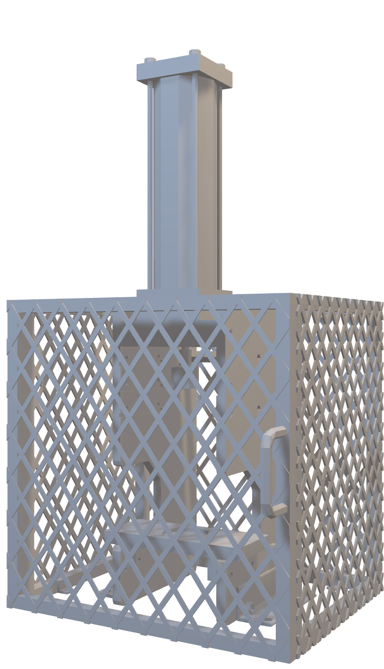
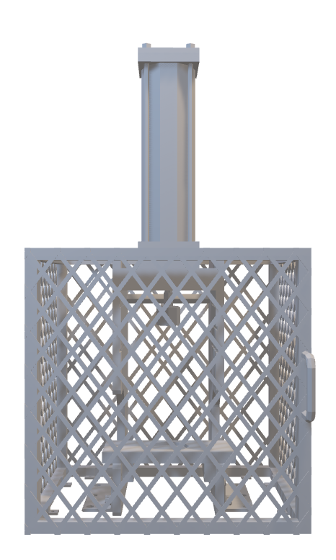
Cage Design
Improvements:
Stronger Material
Pneumatic Lock Incorporation
Improved Ventilation

Slide 38
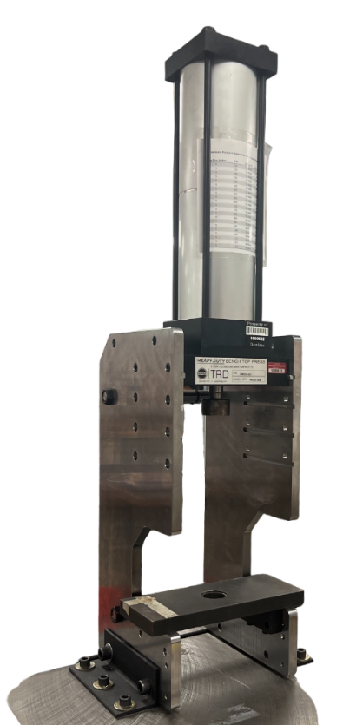
Final Product
Allows for faster cooling of press and parts
May be electrical

Slide 39
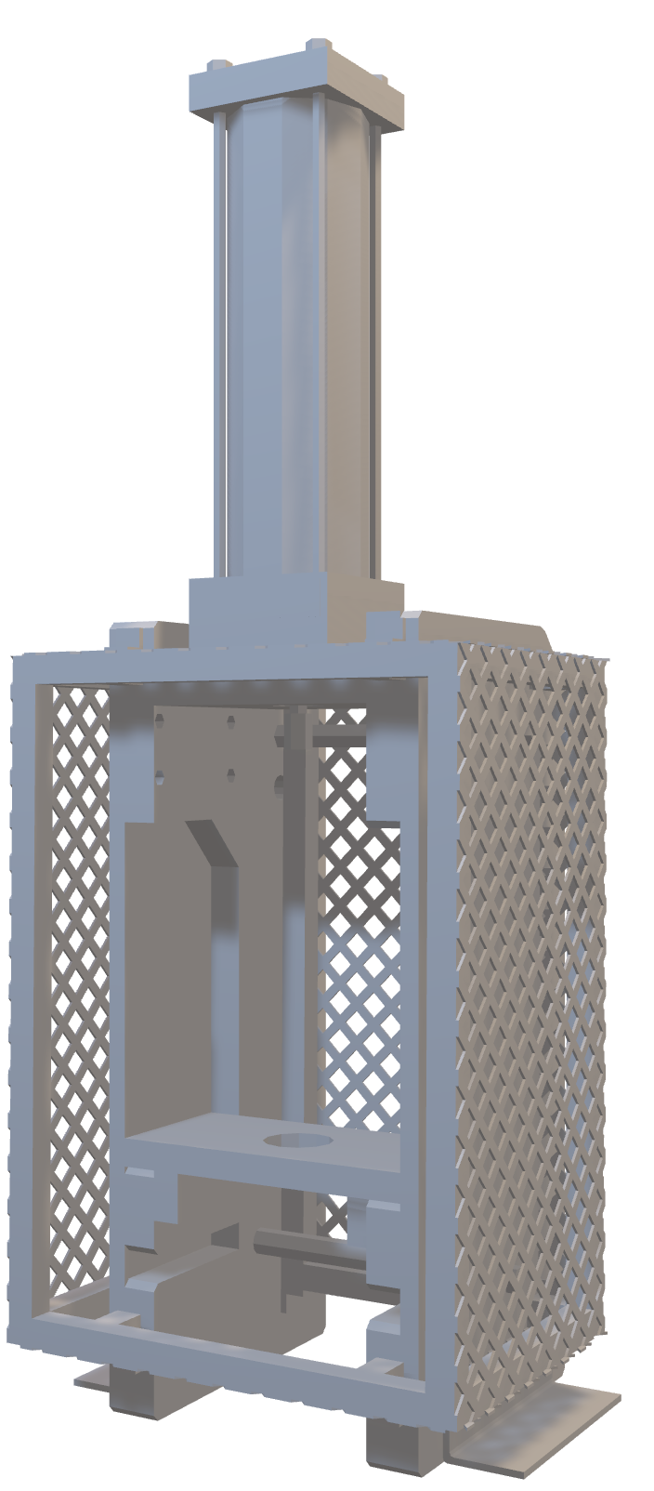
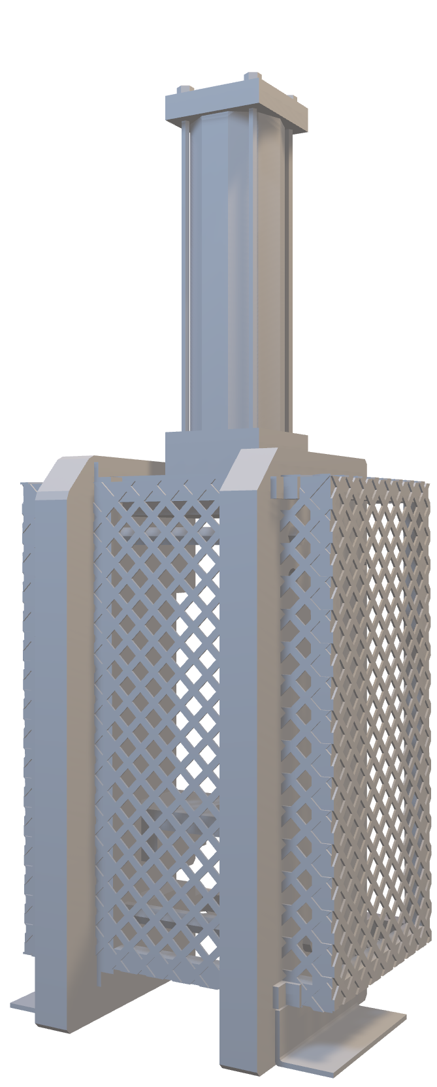
Assessing Design Options
Early design idea: Optional slots below the chuck and integrated cage on press frame
Provided a fix to both the daylight amount and a better cage
Reasons for failure (don’t say this):
Complex design and assembly.
Not enough room for operator’s hands to place the bearing housing.
Actuator with chuck and new shafts were not long enough to reach the bearing housing.

Slide 40
Press Features
Brent Mynard
April 4, 2024

Slide 41




Future Press Features
Keeping The Press Pneumatic

Slide 42
Future Press Features
Should only activate when press is in use
Must recognize when door is open or closed

Slide 43
Future Press Features
Keeping The Press Pneumatic

Slide 44
Future Work: Emergency Stop
Emergency stop must immediately stop all actions
Must override timer
No exceptions

Slide 45

Future Press Features
Keeping The Press Pneumatic

Slide 46
Future Work: Pneumatic Timer
Allows press to continue applying force for set time after actuator is released
Able to be overridden by emergency stop

Slide 47

Future Press Features
Keeping The Press Pneumatic

Slide 48
Feature: Fan
Decreases heat caused by convection currents
Can be electrical

Slide 49
Modified Press Pneumatic Diagram
Pneumatic lock
E-Stop
Air Valve
Compressed Air
2 Stage Cylinder
Chuck
2 Hand Operator
Colby Gullo
49

Slide 50
Budget

Slide 51



Future Work
Safety Guard
Final Tests
Deliver To Danfoss

Slide 52
Project Recap
​Targets and Metrics
SIZE
PRESSURE
SAFETY
​Key Goals
Height
Adjustability
Press Bearing On Shaft Stud
Ensure Safety Of User
Allow User Ease Of Usage
Optimize Cost
​TBD
Cassie Bentley
52

Slide 53





Lessons Learned As A Team
Provide Various Alternatives To The Sponsor
Be Prepared For Setbacks
Have Good Organization
Maintain Consistent Communication

Slide 54



Thank You

Slide 55
Backup Slides

Slide 56
Slides we are not using …....

Slide 57

Original Design
Original Design
The original press had several limitations that prevented it from usage.
CAD Issues:
Not enough room for new shafts and new bearing housing.
Ineffective cage to protect operator.

Slide 58
CAD Modeling: Original Design
Original Design
The original press had several limitations that prevented it from usage.
CAD Issues:
Not enough room for new shafts and new bearing housing.
Ineffective cage to protect operator.

Slide 59

Fall Semester
Current Press

Slide 60
Fall Semester
Providing Regular Updates: Describe how you maintained regular communication with the sponsor, keeping them informed about project progress, milestones achieved, and any potential issues encountered.
Problems:
The current press won't fit the new shaft size
The plexiglass is a safety concern
Press should not operate if door is open

Slide 61
Fall Semester
Providing Regular Updates: Describe how you maintained regular communication with the sponsor, keeping them informed about project progress, milestones achieved, and any potential issues encountered.
Problems:
The current press won't fit the new shaft size
The plexiglass is a safety concern
Press should not operate if door is open

Slide 62
Fall Semester
Providing Regular Updates: Describe how you maintained regular communication with the sponsor, keeping them informed about project progress, milestones achieved, and any potential issues encountered.
Problems:
The current press won't fit the new shaft size
The plexiglass is a safety concern
Press should not operate if door is open

Slide 63
Fall Semester
Providing Regular Updates: Describe how you maintained regular communication with the sponsor, keeping them informed about project progress, milestones achieved, and any potential issues encountered.
Problems:
The current press won't fit the new shaft size
The plexiglass is a safety concern
Press should not operate if door is open

Slide 64

Fall Semester
Find A Press:
Conduct research on various vendors and work closely with our sponsor to comprehend the project's requirements, desires, and financial constraint

Slide 65



Sponsor Communication
Post-Order Adjustments:
After placing the order for the press, we will proceed to make necessary adjustments that were not included with the press to ensure it meets the sponsor's preferences and enhances safety.

Slide 66
CAD Modeling: Original Design
Original Design
The original press had several limitations that prevented it from usage.
CAD Issues:
Not enough room for new shafts and new bearing housing.
Ineffective cage to protect operator.

Slide 67

Bearing Housing
*This slide is to show our process in finding the height for press. I believe these are covered by NDA, so maybe cover pic/dimensions
Dimensions:
Height: 4.9 ~ 5.6 in
Diameter: 3.9 in
Purpose:
Holds the bearing during pressing
Accommodates the different shafts

Slide 68






Team Coordination
Team Lead: Led team in conducting meetings between the sponsor and team.
Systems engineer: Facilitated the design of the new press while salvaging components from the old press and working under budget constraints
Cage design: Communicated with the fabricator and aided with the design of the new cage and lock.
Pneumatic system: Aided in the Design of the pneumatic system and logic of converting compressed air to a pneumatic press.

Slide 69




Current Semester: Milestone Updates
Old Press Design

Slide 70


Old Design
6 $7/8$” stroke
8 $1/2$” clearance
2” chuck

Slide 71




Current Semester: Milestone Updates
New Press Design

Slide 72


Pneumatic Components
Two-Handed Actuator
Emergency Stop
Pneumatic Timer
Door Sensor/Lock
Air Cylinder

Slide 73
Current Semester: Milestone Updates
New Press Design

Slide 74


CAD Modeling
New Design
Original Design
The original press was measured, and CAD drawings were acquired from the manufacturer. From there, the sponsor’s needs were taken in, and a new design was created over several iterations.

Slide 75


Structural Design
Stroke 7"
Daylight: 13 inch
(With chuck: 12.7 inch)
Throat
Bearing housing 5.6"
Clearance between shaft end and bearing housing 1"
Dimensions:
Height: 4.9 ~ 5.6 in
Diameter: 3.9 in

Slide 76


New Design
6 $7/8$” stroke
12 $1/2$” clearance
2 - 2 $1/2$” chuck
1 $4/5$” between new bearing and shaft

Slide 77
This is 10-point
This is 15–point Times
This is 20–point
This is 25–point
This is 30–point
This is 35–point
This is 40–point
This is 50–point
This is 60–point
This is 72–point
Notes:
Use at least 20-point font in Room A105, B134, and B136
Use at least 25-point font in Room B135

Slide 78
College of Engineering Color Palette
1 2 3 4
Pantone: PMS 195 C
RGB: 120, 47, 64
Hex: #782F40
CMYK:19, 90, 50, 55
1 2 3 4
Pantone: Black C
RGB: 0, 0, 0
Hex: #000000
CMYK:0, 0, 0, 100
Garnet
Black
1 2 3 4
RGB: 238, 118, 36
Hex: #EE7624
CMYK:2, 66, 99, 0
1 2 3 4
Pantone: PMS 000C
RGB: 255, 255, 255
Hex: #FFFFFF
CMYK: 0, 0, 0, 0
Fang
Orange
White
Notes:
Avoid 75% Black in B135

Slide 79
Accent Color Palette
1 2 3 4
RGB: 0, 59, 111
Hex: #003B6F
CMYK:
1 2 3 4
RGB: 0, 59, 111
Hex: #003B6F
CMYK:
1 2 3 4
RGB: 251, 236, 93
Hex: #FBEC5D
CMYK:
1 2 3 4
RGB: 219, 215, 210
Hex: #DBD7D2
CMYK:
1 2 3 4
RGB: 251, 236, 93
Hex: #FBEC5D
CMYK:
1 2 3 4
RGB: 219, 215, 210
Hex: #DBD7D2
CMYK:
Tardis Blue
Tardis Blue
Corn
Timberwolf
Corn
Timberwolf
1 2 3 4
RGB: 206, 0, 88
Hex: #CE0058
CMYK: 0, 100, 43, 12
1 2 3 4
RGB: 206, 0, 88
Hex: #CE0058
CMYK: 0, 100, 43, 12
1 2 3 4
RGB: 104, 40, 96
Hex: #682860
CMYK:
1 2 3 4
RGB: 220, 220, 220
Hex: #DCDCDC
CMYK:
Rubine Red
Rubine Red
Imperial
Gainsboro
1 2 3 4
RGB: 72, 146, 155
Hex: #48929b
CMYK:
1 2 3 4
RGB: 64, 224, 208
Hex: #40E0D0
CMYK:
1 2 3 4
RGB: 255, 139, 0
Hex: #FF8B00
CMYK:
Asagi-iro
Turquoise
American Orange
Notes:
Remove American orange add hyperlink grey
Make corn the last for b135
All work in 134 imperial move later
Tardis doesn’t work in b136

Slide 80
F7AB19
D67F15
EE7624
D64615
F73119
Analogous
https://color.adobe.com/create/color-wheel
6E3610
F0A16C
EE7624
6E4931
BASB1C
Monochromatic
A14508
4BED3B
EE7624
250CED
2010A1
Triad
A1470C
FF8C40
EE7624
0098A1
24E2ED
Complementary
28A164
2FED8D
EE7624
0848A1
1871ED
Split Complementary
EDAC2F
3BED93
EE7624
0C6AED
ED2F18
Double Split Complementary
ED660C
C7ED3B
EE7624
0CE1ED
A418ED
Square
BA7E09
87724A
EE7624
60EFCF
09BA61
Compound
AD551A
6E3610
EE7624
FA7625
D46820
Shades
Notes:
These are the variants that work well with Fang Orange. The bolded items show well on the projectors.

Slide 81
85412D
8F3831
782f40
8F3176
792D85
Analogous
https://color.adobe.com/create/color-wheel
C44D69
8E626D
782F40
C48796
451B25
Monochromatic
C43959
78743B
782F40
236178
43A2C4
Triad
C43959
C46078
782F40
25C43D
2F783A
Complementary
93C460
577835
782F40
39C49D
297861
Split Complementary
784435
5A783B
782F40
237860
6E2978
Double Split Complementary
782337
78683b
782F40
237830
293978
Square
AB4D32
DEBAAF
782F40
5D8555
70AB32
Compound
38161E
C44D69
782F40
853447
5E2532
Shades

Slide 82
A105
A105
B135 Stage Left
B135 Stage Right
B136
B134, A105
B135

